Slide 1
Download Nirmal Bang BO
from Play Store

Slide 2
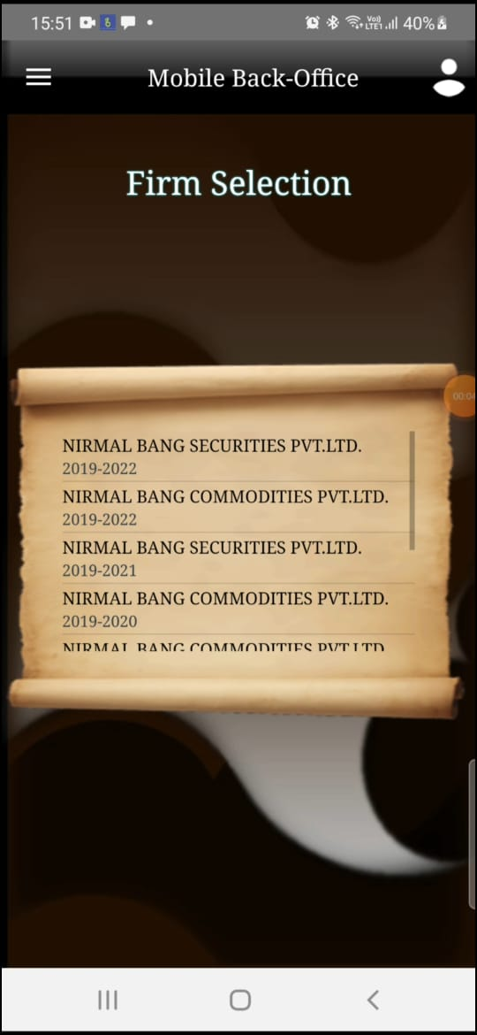
Select Latest Year
(Nirmal Bang Securities Private Limited – 2019 -2022)

Slide 3
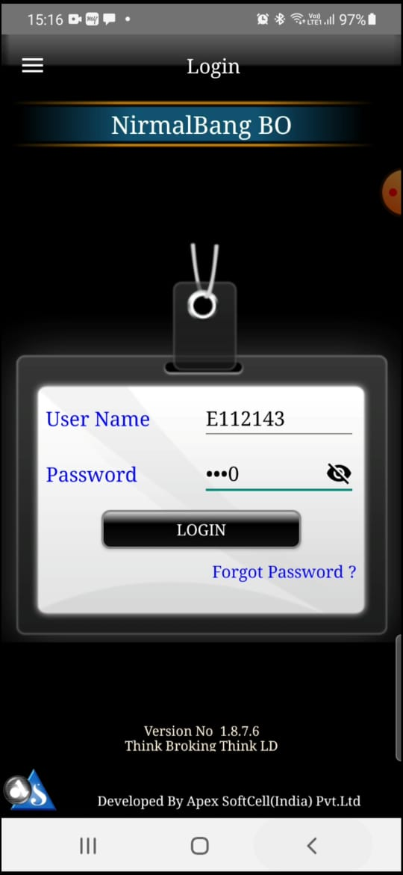
Insert your User Name, Password & click on Login

Slide 4
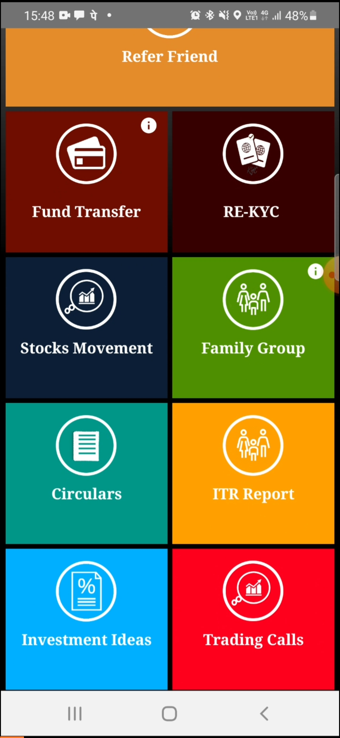
Click on RE-KYC

Slide 5
1. Click On Bank

Slide 6
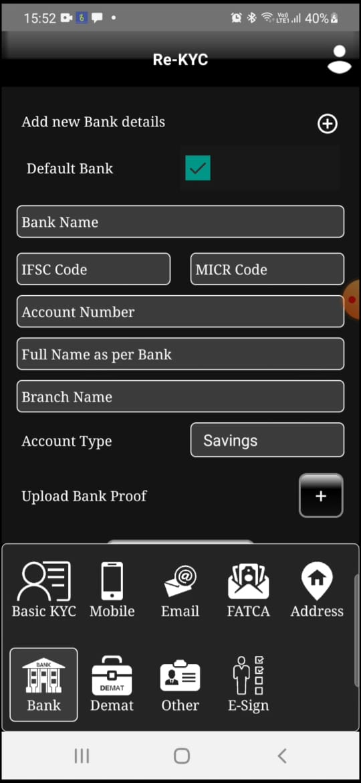
2. If you wish to default your bank in Trading & Demat account, please select Default Bank,
1. Click on + for add bank

Slide 7
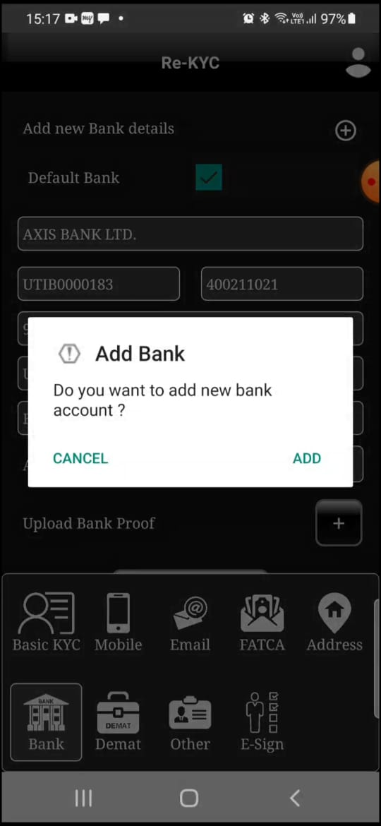
Click on ADD

Slide 8
2. Type your Bank Name

Slide 9
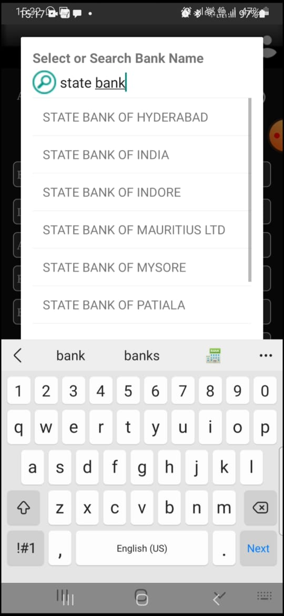
Select your Bank Name

Slide 10
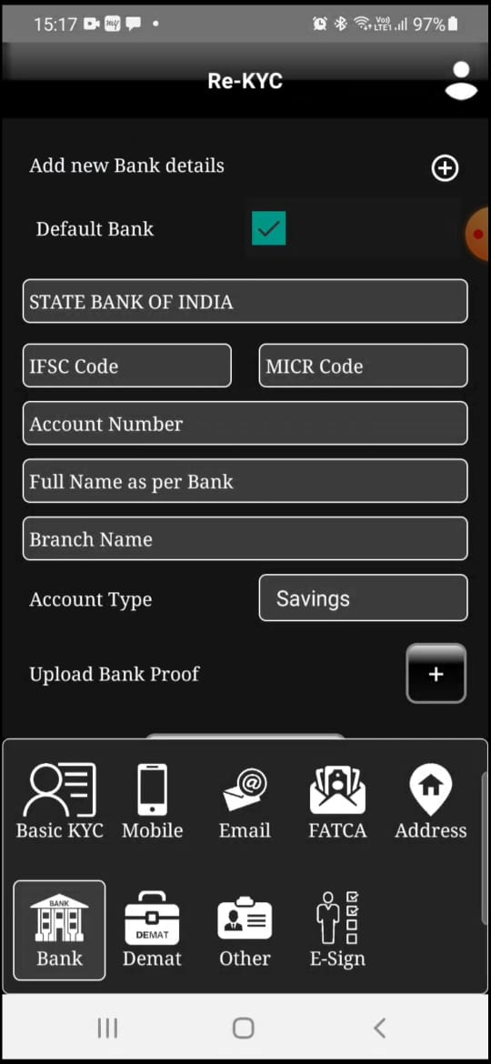
1. Type your Bank details
2. Click on + for upload bank proof

Slide 11
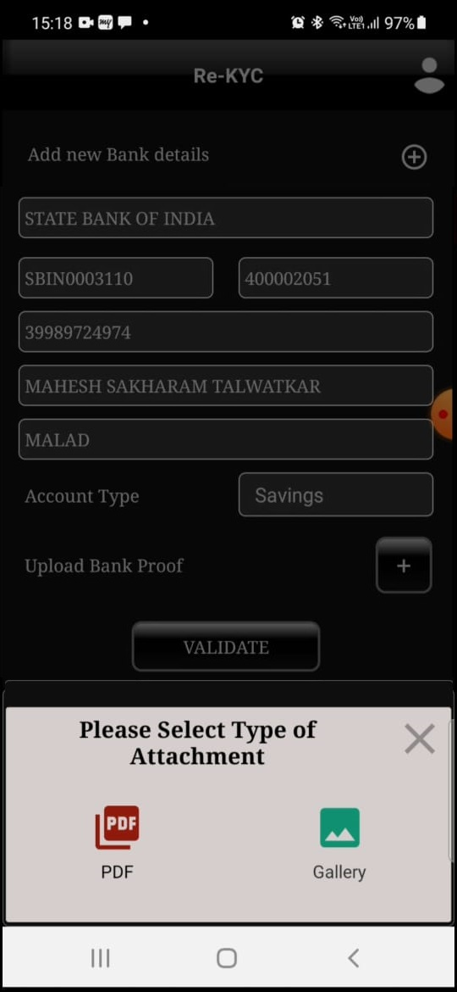
Click on VALIDATE
Please select Type of Attachment PDF or Gallery (for jpg file select Gallery)

Slide 12
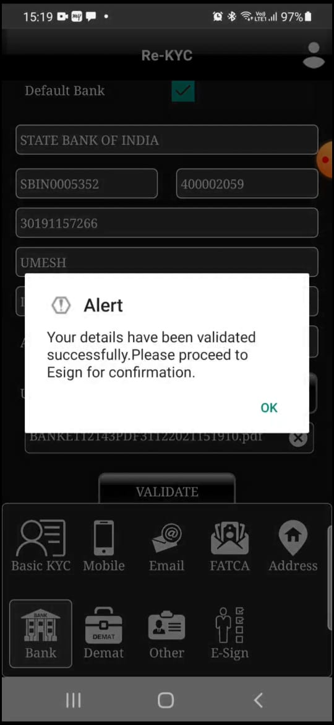
Click on OK

Slide 13
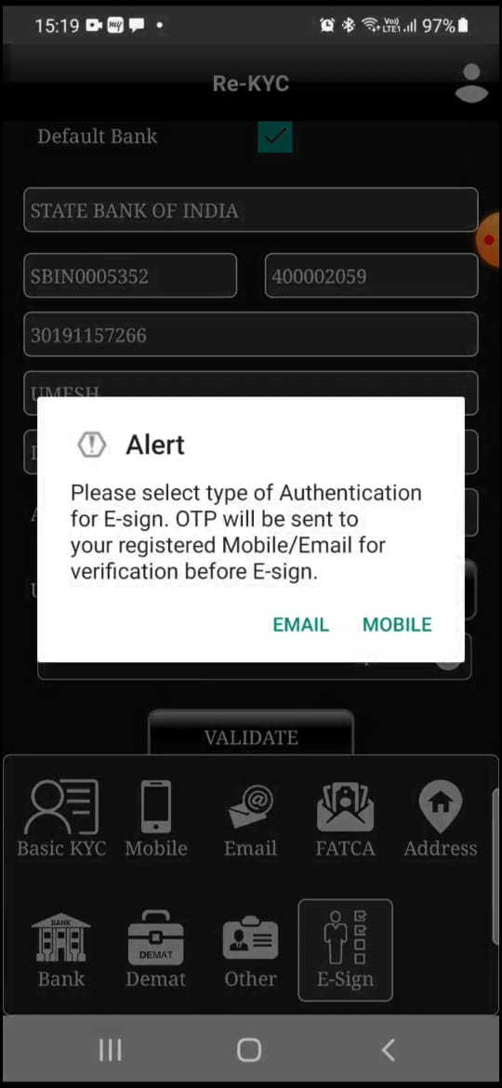
Click on Mobile
Click on E-Sign

Slide 14
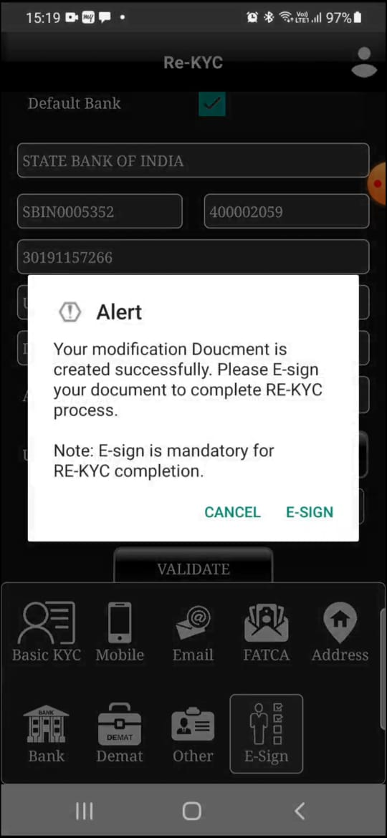
Click on E-Sign

Slide 15
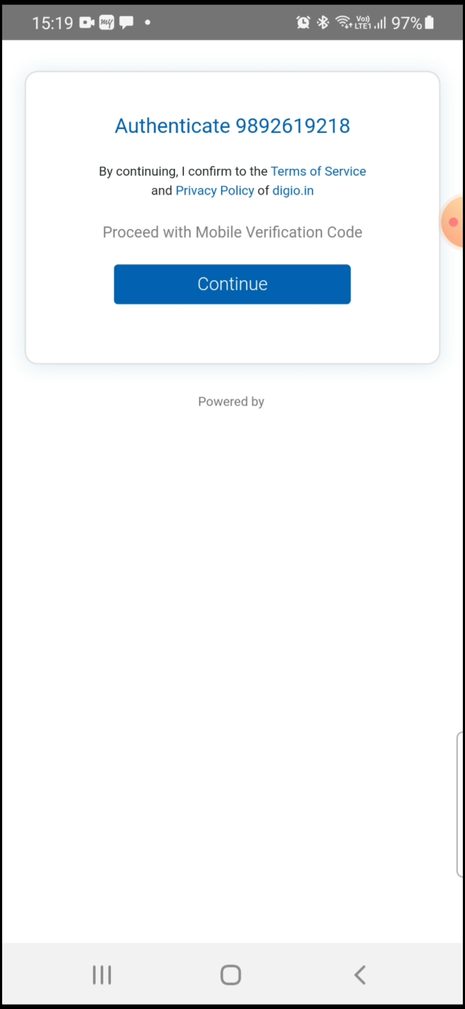
Click on Continue

Slide 16
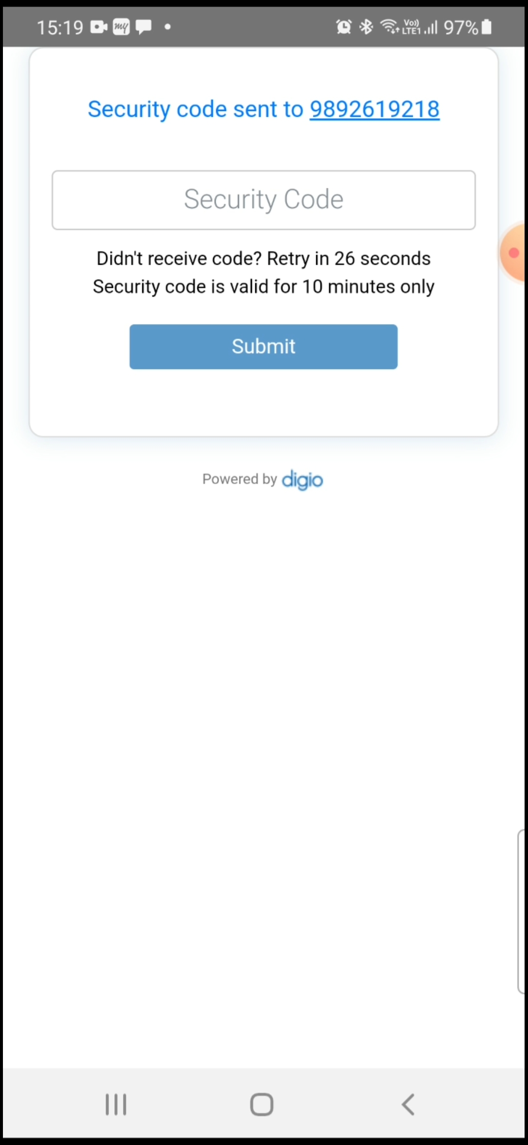
Enter OTP and click on Submit OTP will be received on users registered MOBILE Number

Slide 17
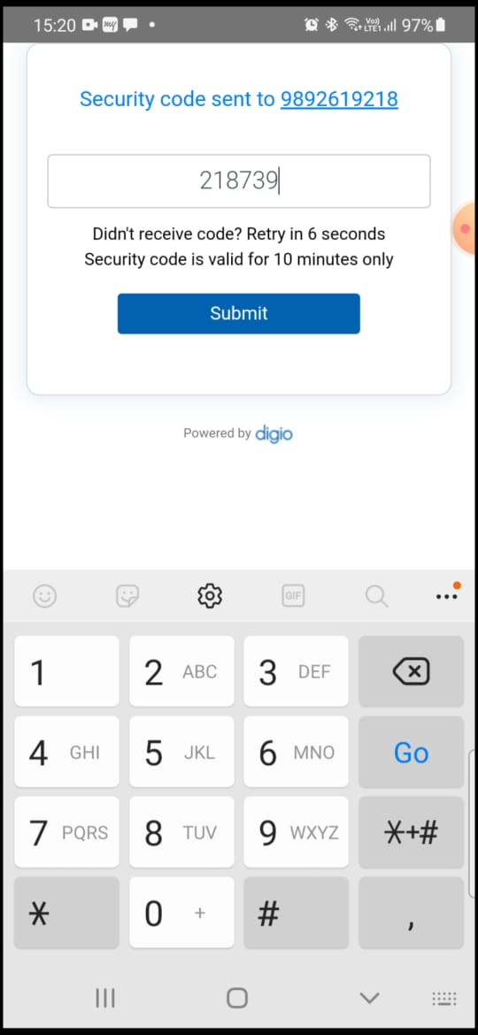
Enter OTP and click on Submit OTP will be received on users registered MOBILE Number

Slide 18
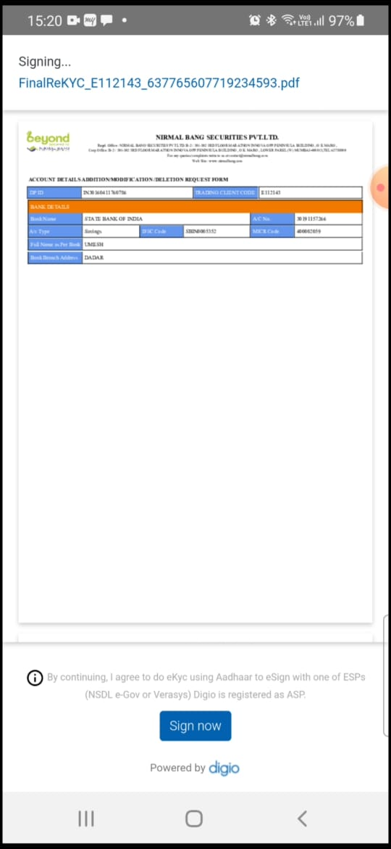
Click on Sign now

Slide 19
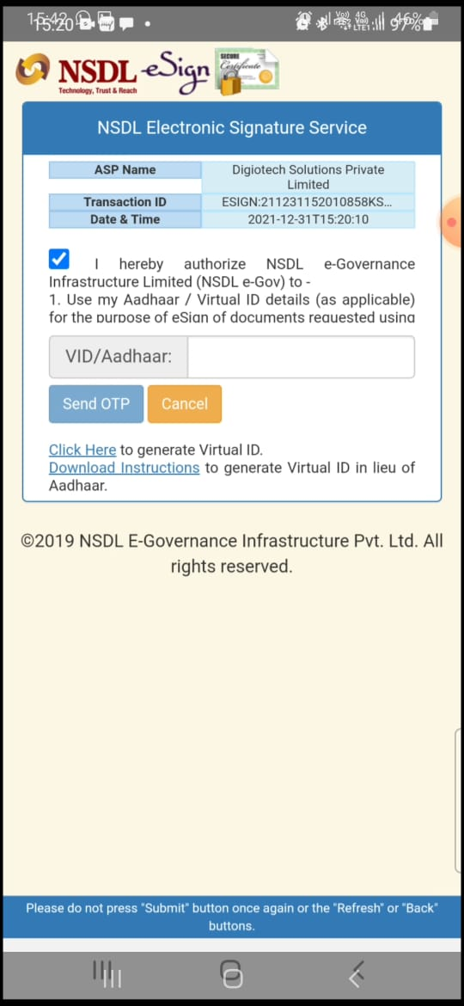
Click on “I hereby authorise”, and Enter Aadhaar Number then Click on Send OTP

Slide 20
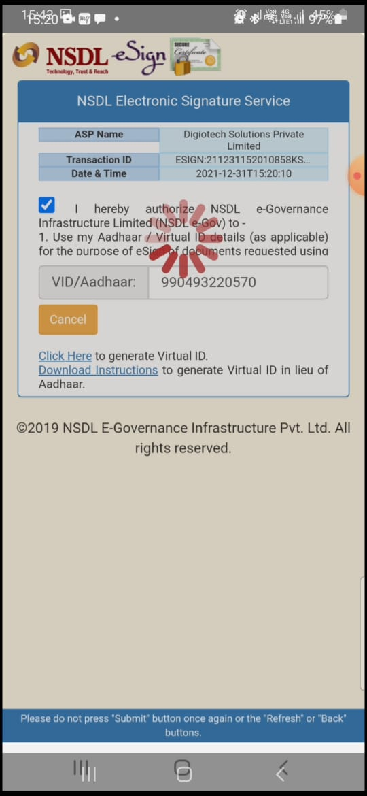

Slide 21
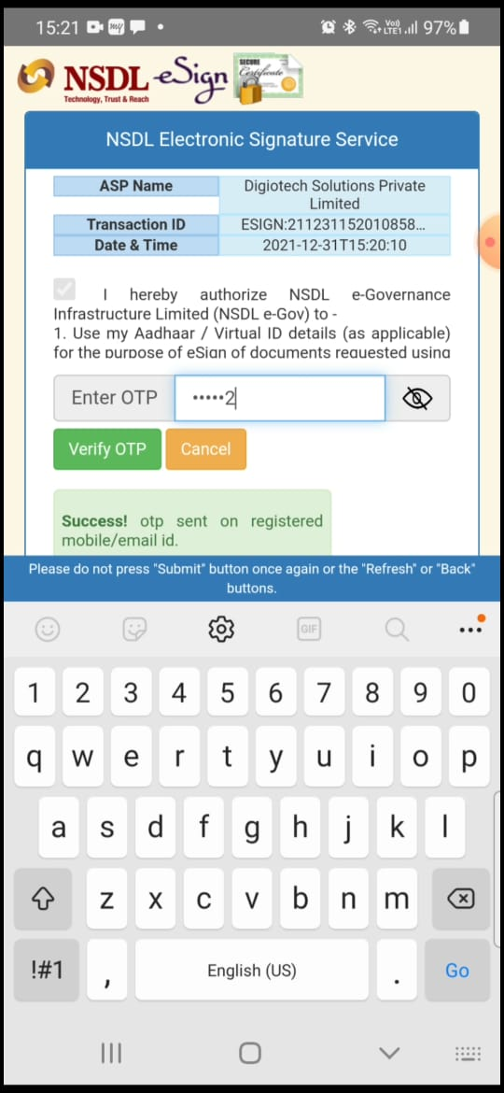
Enter OTP and click on Verify OTP otp will be received on registered MOBILE Number which is linked in aadhaar

Slide 22
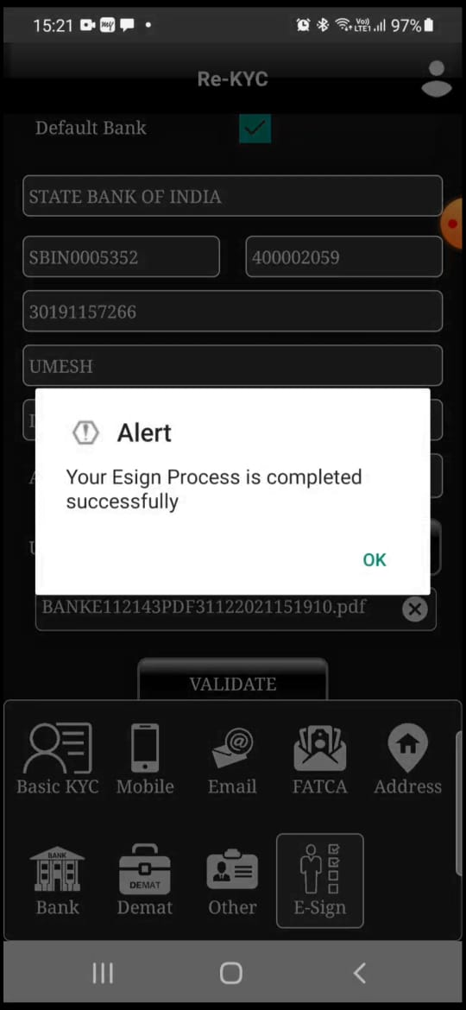
Your request will be in under process for further verification
Click on OK

